Slide 1


Hospital Management System Database
Streamlining Healthcare Operations with MS SQL Server.
Complete database solution for hospital management.
Objective: Improve efficiency, accuracy, and patient care.
by Tharun Ravula

Slide 2





Current Challenges in Hospital Management
Manual Data Entry
Time-consuming and prone to errors.
Doctor Workflow
Struggles to track patient information efficiently.
Appointment Conflicts
Scheduling conflicts and delays impact patient care.
Billing Inconsistencies
Problems with payment tracking and accuracy.

Slide 3





Database-Driven Hospital Management System
Centralized Data
Automated Records
Streamlined Scheduling
All hospital data stored securely.
Efficient patient record management.
Improved appointment management.
Integrated Billing
Seamless financial transactions.

Slide 4






Database Architecture
Patients
1
2
Doctors
Personal info, contact details.
Staff profiles, specializations.
Bills
Departments
6
3
Financial transactions, payments.
Hospital organization.
Medical Records
Appointments
Diagnosis, treatment history.
5
4
Scheduling, visit management.

Slide 5
Patient Management Capabilities
Key Features
Benefits
Quick patient lookup and filtering.
SELECT * FROM Patients;
Demographics-based health campaigns.
Age-specific treatment prioritization.
SELECT firstname, lastname, phonenumber FROM patients WHERE gender='Female';
SELECT firstname, lastname, DOB FROM patients ORDER BY DOB DESC;

Slide 6


Appointment Management System
Track Completed
View past appointments by date.
SELECT * FROM appointments WHERE status='Completed' ORDER BY appointmentdate DESC;
Smart Status
Assign status: Upcoming, Today, Past.
CASE WHEN AppointmentDate > GETDATE() THEN 'Upcoming' WHEN AppointmentDate = GETDATE() THEN 'Today' ELSE 'Past' END AS AppointmentStatus

Slide 7
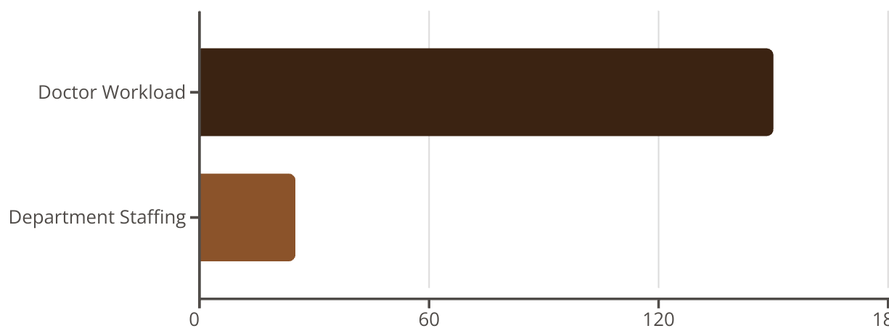
Advanced Analytics & Reporting
Data-driven decision making for hospital operations.
Analyze doctor workload and department staffing.

Slide 8
Financial Management
Pending Payments
Revenue Tracking
Identify outstanding bills.
Monitor patient-specific revenue.
SELECT * FROM bills WHERE paidamount < totalamount;
SELECT PatientID, TotalAmount, PaidAmount, (TotalAmount - PaidAmount) AS Outstanding FROM Bills;

Slide 9



Security & Data Privacy Features
Data Masking
Mask sensitive phone numbers for privacy.
SELECT REPLACE(Phonenumber, SUBSTRING(Phonenumber, 4, 3), '***') AS MaskedPhone FROM Patients;
Non-Sensitive Views
Create public views for limited data access.
CREATE VIEW PublicAppointments AS SELECT appointmentid, doctorid, appointmentdate FROM Appointments;

Slide 10

Results & Future Enhancements
50%
99.9%
Time Reduction
Data Accuracy
In data entry.
Through constraints.
40%
ROI
Operational efficiency.
Future: Web UI, mobile app, AI diagnosis, telemedicine, insurance automation.

